Slide 1
This presentation was created on a blank, basic PowerPoint template to allow you the ability to import branding (logos) for your radio station(s).
You will also note that throughout, we indicate (insert advertiser here), identify an advertiser as “Advertiser X” and include (insert market) – please replace those with the name of the advertiser and the market you represent before you pitch.
In addition, we refer to your station(s) as “Radio Station” – please fill in your call letters or station ID.
Please delete this slide prior to your presentation.
Need assistance? View in slide show mode and click on the ask RAB logo.

Slide 2
Presented by:
Insert your name and title
Leveraging Radio to Drive Mental Health Awareness
Partnership with the Ad Council & Huntsman Mental Health Institute
(Insert date of meeting)
INSERT RADIO STATION LOGO(S)

Slide 3
Agenda
America’s Mental Health Crisis
Leading with Purpose Builds Brands
Radio’s Supports Communities to Inspire Action
Partnership with the Ad Council & Huntsman Mental Health Institute
Join the Movement

Slide 4
America’s Mental Health Crisis
Nearly 70 million of Adults are struggling with mental health Challenges but are unlikely to seek help.
58% don’t want to burden others.
47% are concerned they would be judged unfairly
Source: Ad Council, 2024

Slide 5
We Can Help
Together, with resources provided by the Ad Council, Huntsman Mental Health Institute, (insert radio station/group/network) can help Advertiser X demonstrate its support for a healthier, inclusive and productive (insert community.)

Slide 6
Leading with Purpose Matters
89% of business leaders believe companies that lead with purpose have a competitive advantage in today's marketplace.
When a company leads with purpose, consumers are 72% more likely to be loyal to that company.
71% of consumers would purchase from a purpose-driven company over the alternative when cost and quality are equal.
Over one-third of U.S. adults express an increased likelihood to shop at a business associated with a cause.
Marketers committed to purpose-driven marketing are poised to capture attention and loyalty among an increasingly conscientious consumer base.
Sources: Porter Novelli Purpose Study 2021, Civic Science, 2023, Matter Unlimited, 2024

Slide 7
Purpose is Radio’s DNA
RADIO
INFORMS
RADIO
CONNECTS
RADIO
ALLEVIATES
RADIO
HELPS
55% of listeners say radio provides them with companionship.
45% of listeners say radio keeps me company.
37% of listeners say radio improves their mood.
30% of listeners say radio helps them escape the pressures of everyday life.
Sources: Jacobs Media Techsurvey 2024

Slide 8
Radio Leads with Purpose
RADIO
INFORMS
RADIO
CONNECTS
RADIO
ALLEVIATES
RADIO
HELPS
Each day, thousands of radio broadcasters support charities and victims of disasters and create awareness about important health and safety issues.
Broadcast Radiothon partners raised over $33 million to support Children’s Miracle Network Hospitals in 2023. ​
During the 2023 holiday season alone, more than $28 million in community service was donated by radio stations across the country.
Sources: NAB; Childrens Miracle Network Hospitals 2024; Radio Ink , January 2024

Slide 9
Radio Reaches All Consumers
Radio is a top reach medium for adults of all ages.
Highest among traditional media.
Source: Nielsen Total Audience August 2020

Slide 10
Radio Connects with People in Need
61%
28%
46%
Of radio listeners like to give the impression that their life is under control
Of radio listeners feel like their life is slipping out of control.
Of radio listeners find juggling family and work demands to be very stressful
Source: MRI Simmons 2023 Fall Doublebase

Slide 11
Radio Is Poised to Help
Radio reaches those that have used mental healthcare services in the past three years.
81%
82%
83%
Adults 18+
African American Adults 18+
Hispanic Adults 18+
Source: Scarborough USA+ 2023 Release 2 Total (June 2022 – October 2023)

Slide 12
Why YOUR Radio Station
Insert key facts as to why your radio station is the right medium to spread the mental health awareness message on behalf of Advertiser X.

Slide 13
Objectives
Raise awareness, reduce stigma and make taking care of mental health a priority in (INSERT MARKET.)
Establish Advertiser X as a trusted and committed supporter of the free resources provided by the Ad Council and Huntsman Mental Health Institute.

Slide 14
Strategies
Leverage the credibility of the Ad Council and Huntsman Mental Health Institute and support efforts to reach individuals and inspire them to adopt strategies and seek help.
Position Advertiser X as a brand that exemplifies shared values of community members.
Turnkey program that effectively uses all radio station platforms to engage the audience with the support available to address mental health challenges.

Slide 15
Unprecedented Partnership with the Ad Council
ADULT MENTAL HEALTH

Slide 16
Campaign Target & Objectives
Target Audience
Adults,18-44 who are struggling with their mental health and hold attitudes and beliefs that may discourage help-seeking behaviors.
Normalize
Educate
Connect
Notes:
Target Audience:
Population:
32% of adults 18-44
50% White/50% Multicultural
Mental Health Status
Self report struggling or surviving with their mental health
Over index on anxiety & depression
Attitudes & Barriers to help seeking behavior
Less likely to prioritize their mental health
More likely to feel ashamed about sharing their mental health struggles
Lack confidence with taking care of their mental health
More likely to see reaching out for help as a sign of weakness

Slide 18
Campaign Strategy
The Problem
Our audience doesn’t see the tangible value of caring for their mental health
Strategic Solution
Position mental health as their greatest asset for success

Slide 19
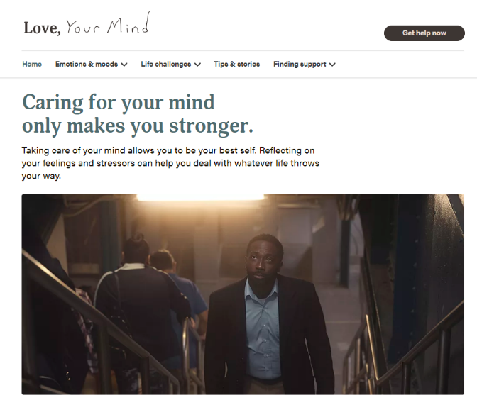
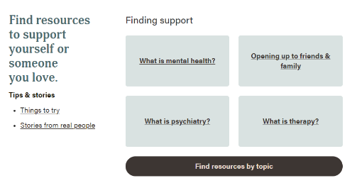
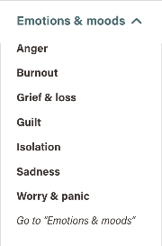
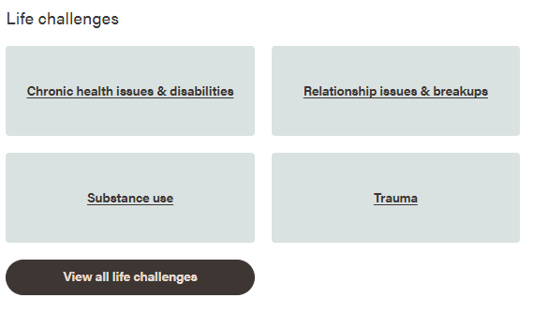
CALL TO ACTION:
Love Your Mind Campaign Website
LoveYourMindToday.org
ConAmorTuMente.org

Slide 20
:30 and :60 Radio
“Sitcom”
“Engine”
“Engine”
“Telenovela”
English
Spanish
Pre-approved, likely to be approved and guidelines for sponsor tag copy available at www.rab.com/loveyourmind

Slide 21
Short Form :10 Radio
Love your mind, (location). Huntsman Mental Health Institute and the Ad Council have resources at LoveYourMindToday,org. This message supported by (insert brand)
Taking care of yourself is important. Huntsman Mental Health Institute and theAd Council can help with resources at LoveYourMindToday.org. This message supported by (insert brand)
Feeling overwhelmed? Huntsman Mental Health Institute and the Ad Council can help with resources at LoveYourMindToday.org. This message supported by (insert brand)
All copy available in Spanish at www.rab.com/loveyourmind

Slide 22
Short Form :10 Radio
Take a moment for your mental health. Huntsman Mental Health Institute and the Ad Council have resources at LoveYourMindToday.org. This message supported by (insert brand)
Looking for mental health resources? Check out LoveYourMindToday.org, brought to you by Huntsman Mental Health Institute and the Ad Council. With additional support from (insert brand)
Everyone struggles with mental health now and then. Huntsman Mental Health Institute and the Ad Council have resources to help you get through tough times at LoveYourMindToday,org. This message supported by (insert brand)
All copy available in Spanish at www.rab.com/loveyourmind

Slide 23
Short Form :15 Radio
Want to go further? Think about your mental health. Huntsman Mental Health Institute and the Ad Council have resources for you at LoveYourMindToday.org. When you’re healthy, you never know how far you can go. This message paid for by (insert brand)
Taking care of our community means taking care of everyone’s mental health. Huntsman Mental Health Institute and the Ad Council are here to help. Find out more at LoveYourMindToday.org. This message supported by (insert brand)
There’s a lot going on out there, that’s why it’s especially important to think about your mental health. Huntsman Mental Health Institute and the Ad Council, have resources for you at LoveYourMindToday.org. This message paid for by (insert brand)
All copy available in Spanish at www.rab.com/loveyourmind

Slide 24
Short Form :15 Radio
Feeling overwhelmed? You’re not alone. Huntsman Mental Health Institute and the Ad Council have resources for you at LoveYourMindToday.org. Because your mental health is important. This message paid for by (insert brand)
Hey. It’s me, your mind, reminding you there’s never a bad time to check out your mental health. Huntsman Mental Health Institute and the Ad Council have resources for us at LoveYourMindToday.org. This message paid for by (insert brand).
All copy available in Spanish at www.rab.com/loveyourmind

Slide 25
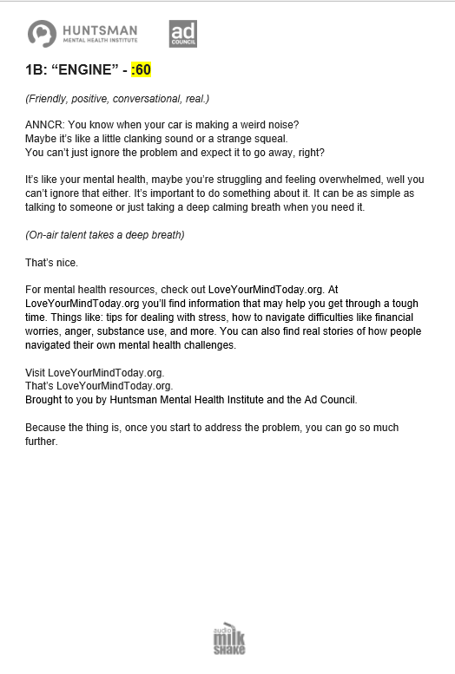
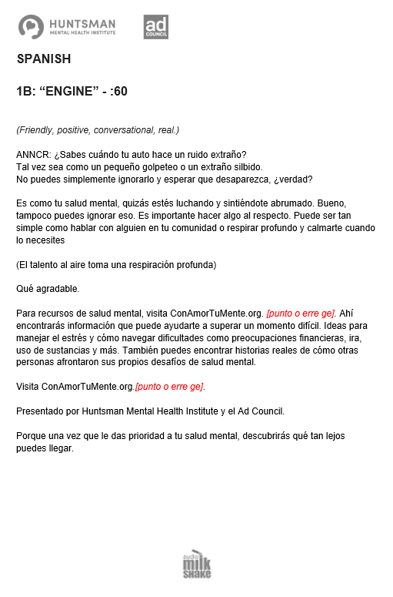
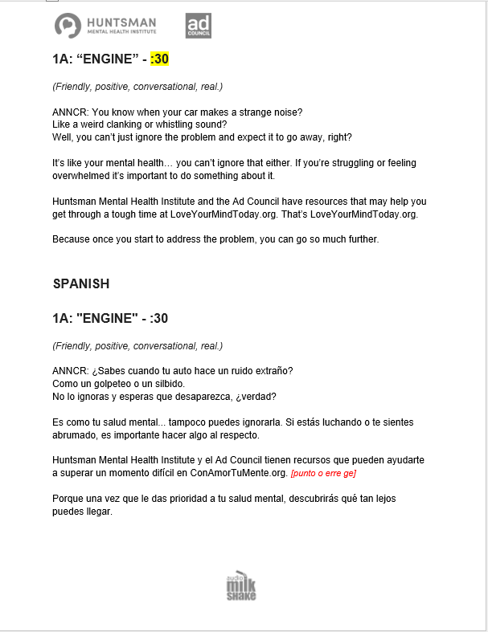
Live Read
Additional scripts at www.rab.com/loveyourmind. All copy available in English & Spanish.

Slide 26
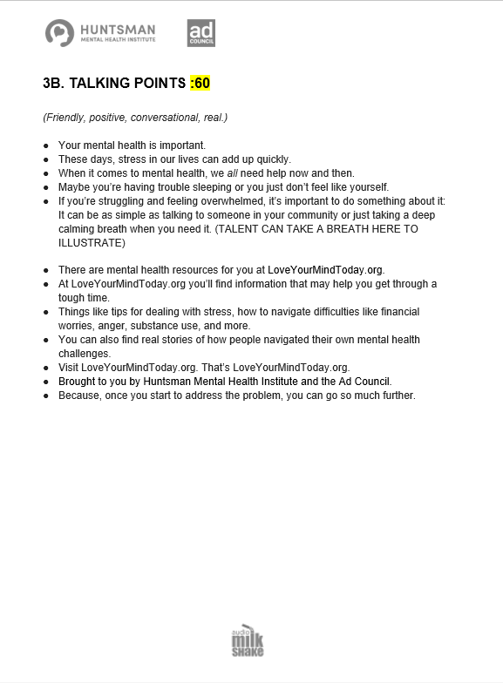
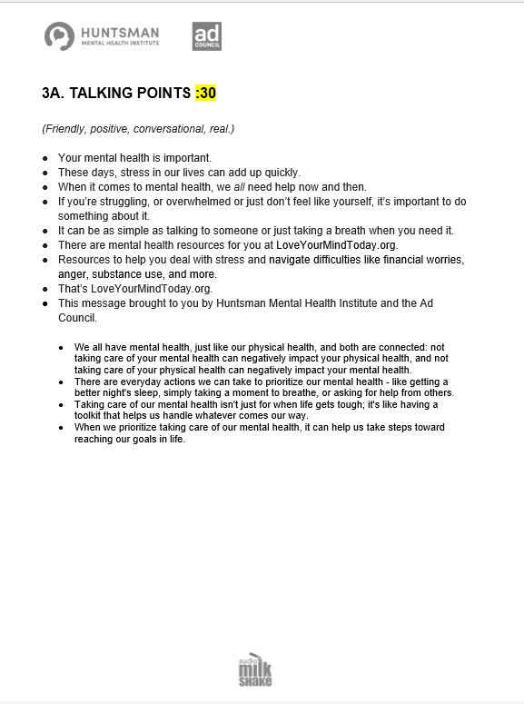
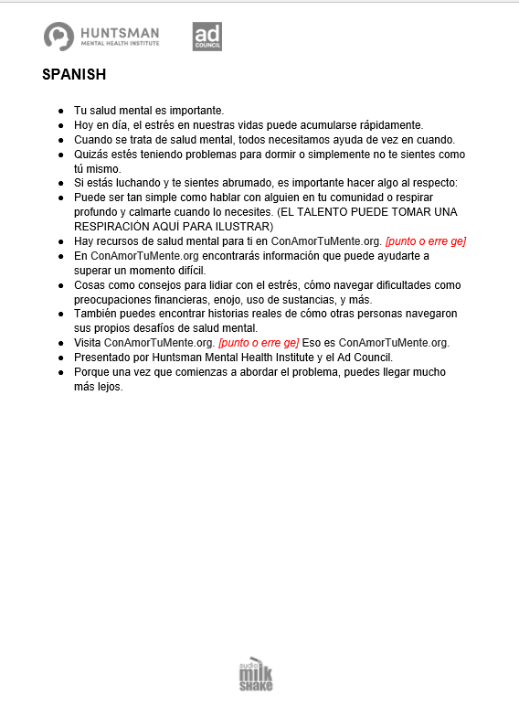
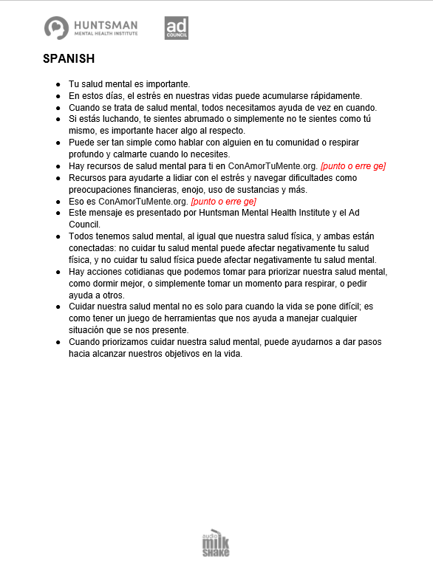
Host/Influencer Talk Points
Talk points available for :30/:60 Spanish and English at www.rab.com/loveyourmind

Slide 27
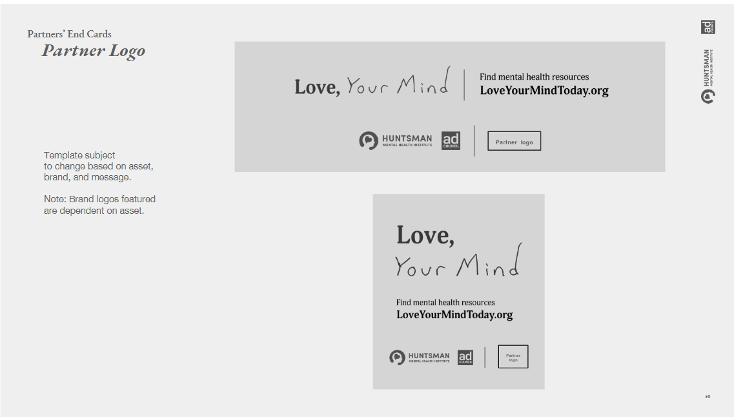
Digital

Slide 28
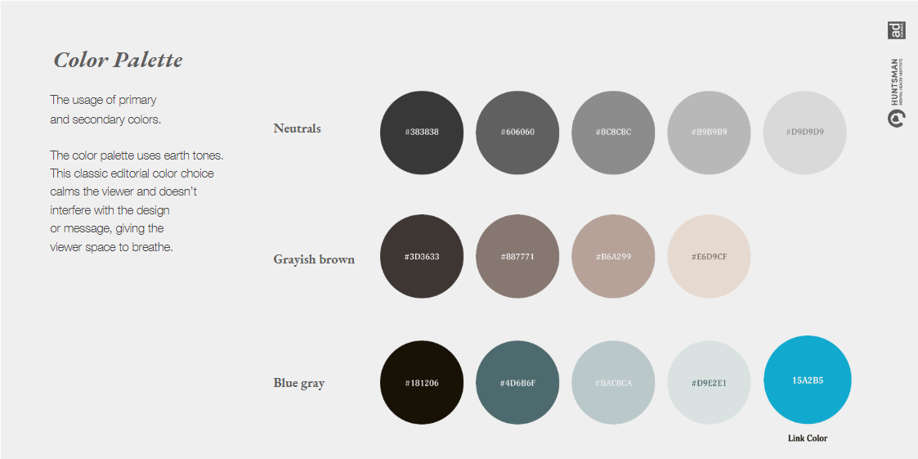
Digital

Slide 29
Join the Movement: Next Steps
Advertiser X “Joins the Movement” and allocates budget.
Radio station creates media schedule.
Radio station and Advertiser X create sponsorship tag copy per Ad Council guidelines and submits by clicking the approval link via www.rab.com/loveyourmind for Ad Council approval or feedback.
Plan activation timeline including commercial creative and station-produced spots (if required).
Launch campaign.

Slide 30
ABOUT THE AD COUNCIL

Slide 31
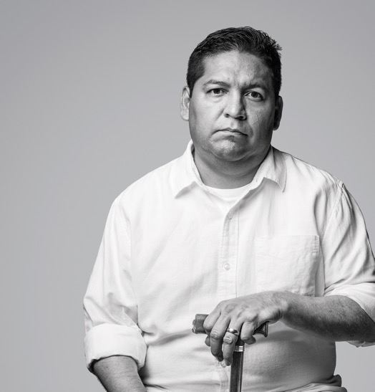
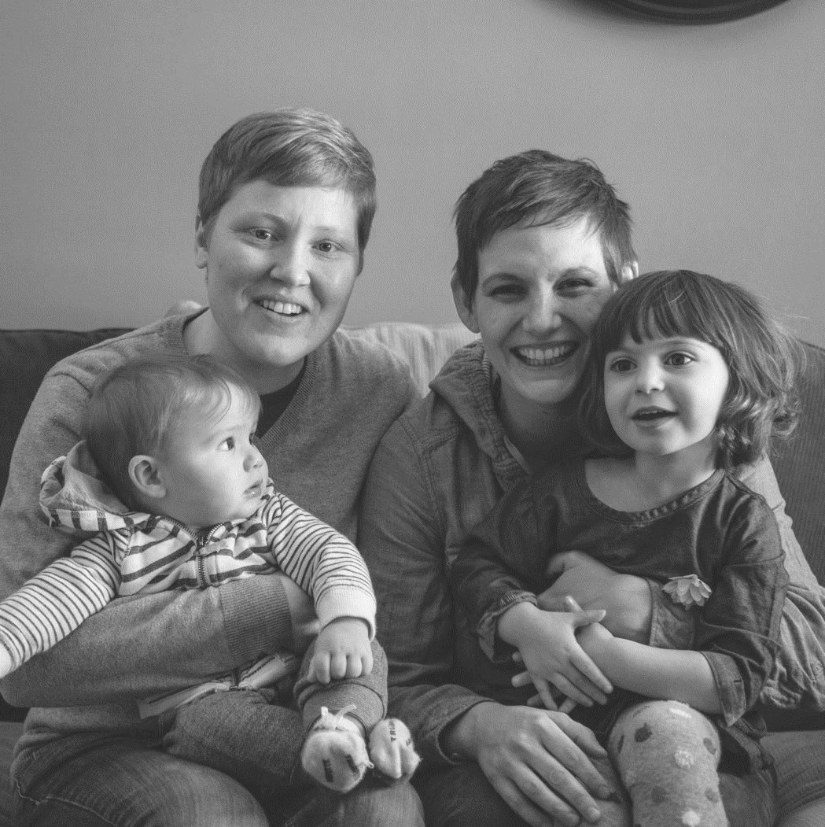
AD COUNCIL USES
THE POWER OF
COMMUNICATIONS
TO TACKLE THE
TOUGHEST ISSUES

Slide 32
MEDIA
NON-PROFIT
MARKETING
TECH
GOVERNMENT
ADVERTISING
Notes:
The Ad Council uses the power of communications to drive impact on America’s most pressing social issues.
We build powerful, one-of-a-kind coalitions across the advertising, tech, media, marketing, gov’t and non-profit sectors to create innovative, results-oriented communications campaigns that create a lasting impact on culture and society.
By leveraging our unique network, pro-bono resources, and more than $1B in donated media annually, we can amplify and accelerate our collective reach exponentially

Slide 33
OUR TRACK RECORD ON CHANGING THE NARRATIVE
MENTAL
HEALTH
Notes:
Let’s start with a sobering number. There are over 48,000 gun deaths in the U.S. in 2021. This is a record-breaking, all-time high.

Slide 34
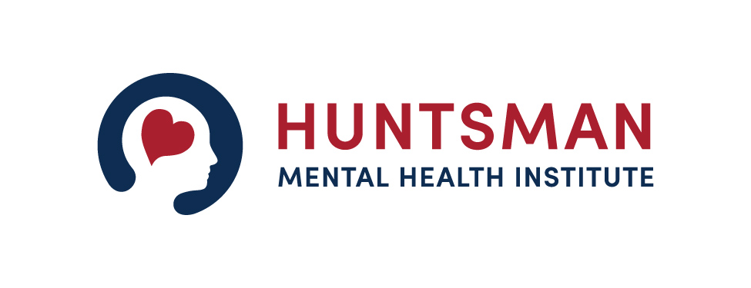
ABOUT HUNTSMAN MENTAL HEALTH INSTITUTE

Slide 35
Huntsman Mental Health Institute brings together 75 years of patient care, research and education into one of the nation's leading academic medical centers focused on mental health.
Nestled in the campus of University of Utah, Huntsman Mental Health Institute serves the community with 1,600 faculty and staff in 20 locations providing inpatient and outpatient services for youth, teens, and adults as well as a comprehensive crisis care model which includes the nationally recognized SafeUT app and the 988 Crisis hotline for Utah.
Our mission is to advance mental health knowledge, hope, and healing for all.
www.huntsmanmentalhealthfoundation.org/hmhi/
Notes:
Quick talking points about Huntsman Mental Health Institute:
● Huntsman Mental Health Institute aims to reduce mental health stigma and promote
healing across the nation.
● Huntsman Mental Health Institute is the organizing partner for Stop Stigma Together, a
national coalition of organizations working to end stigma related to mental health and
substance use disorders.
● In November of 2019, the Huntsman Family made a $150 million commitment to the
University of Utah to establish Huntsman Mental Health Institute. The Huntsman family’s
philanthropic journey has been a multi-generational commitment to end human suffering
and has focused on addressing mental health and combating cancer.

Slide 36
Huntsman Mental Health Institute researchers are a pioneering force in expanding the understanding of complex functions of the brain. Innovation has come from brain imaging and genetic studies related to addiction, suicide prevention, depression, and other disorders, including the world’s largest study on the relation between genetics and suicide.
Huntsman Mental Health Institute’s education program through the Spencer Fox Eccles School of Medicine boasts highly competitive general psychiatry and triple-board residency programs, bringing the nation’s best clinicians to Utah. Unique educational fellowships include care focused on rural populations, addiction, and forensic psychiatry.
Huntsman Mental Health Institute, anchored by a 170-bed acute psychiatric and substance use hospital, is part of a world-renowned academic health system at the University of Utah.
www.huntsmanmentalhealthfoundation.org/hmhi/

