Slide 1


Slide 2


Slide 3
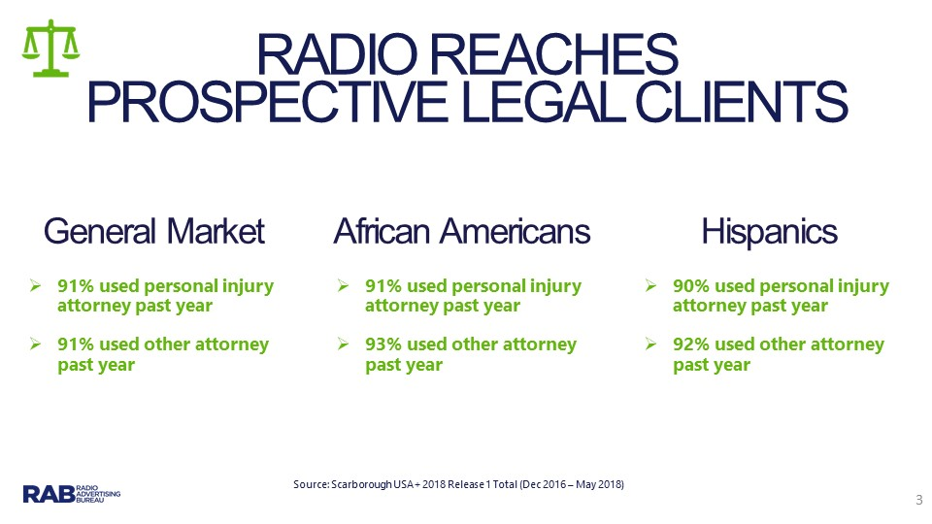

Slide 4
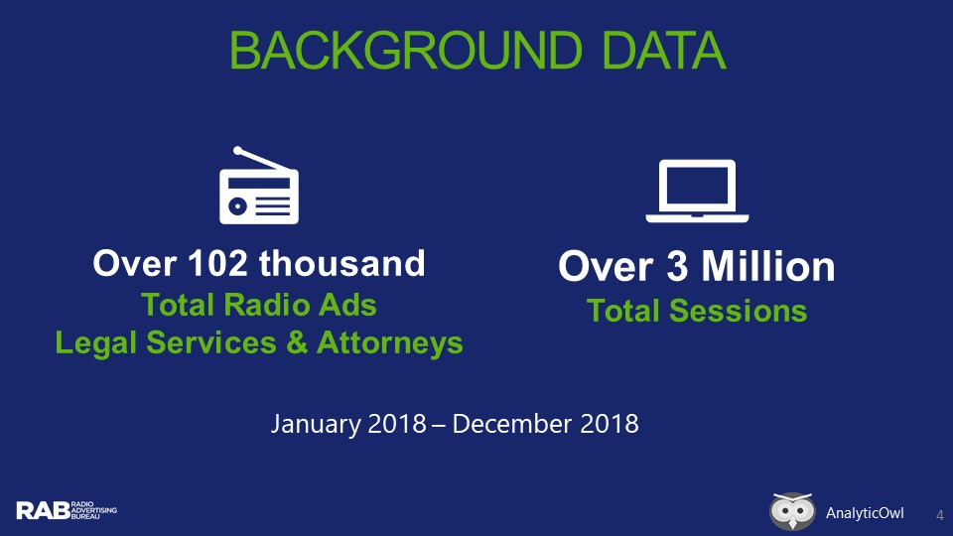

Slide 5
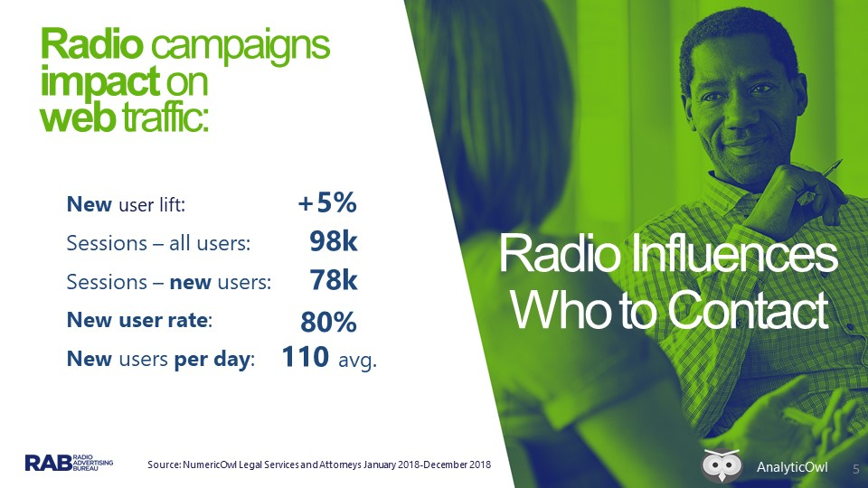

Slide 6
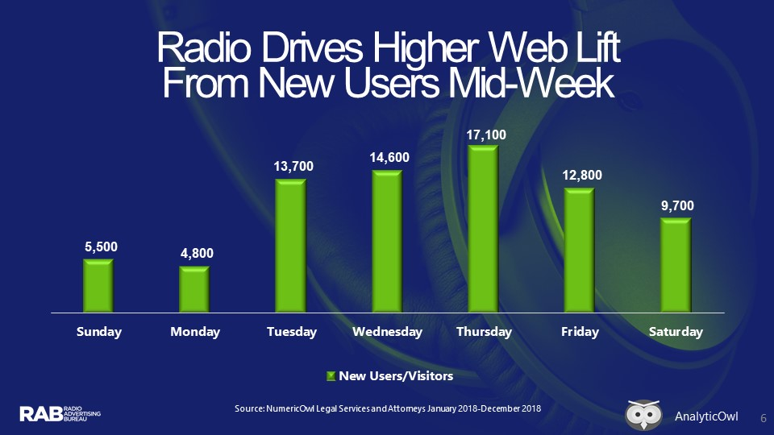

Slide 7



RADIO’S WEB TRAFFIC
Influence by Daypart – Legal Services and Attorneys
Midday |  | Afternoon | Morning | Evening | Overnight
10AM-3PM |  | 3PM-7PM | 6AM-10AM | 7PM-12M | 12M-6AM
Highest new site visitors | Second highest number of new site visitors |  | Drove nearly as many new site users as Afternoon | Delivered 77% of Morning | Delivered 6k new users
Insight: While Midday drove the highest number of users, overnight also drove search
Source: NumericOwl Legal Services and Attorneys January 2018-December 2018
AnalyticOwl

Slide 8
